Slide 1
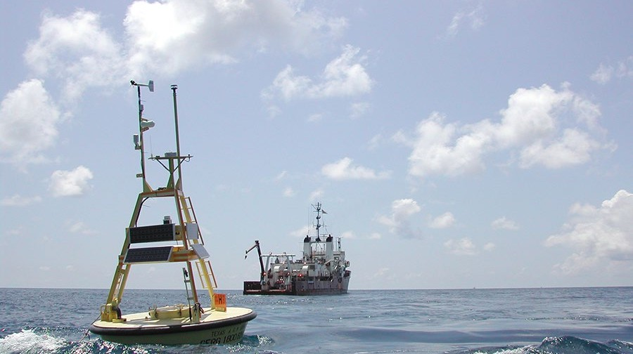

Working with Texas Automated
Buoy System (TABS)
Lab 4 | Working with TABS
OCNG 470 Data Analysis Methods in Geosciences Fall 2025 TAMU Oceanography
Oceanography
OCNG 470 Data Analysis Methods in Geosciences (Lab portion)

Slide 2
Lab 5 Assignment
Lab Objectives:
Learn how to access and retrieve data from the Texas Automated Buoy System (TABS)
Import your data into a MATLAB using readtable()
Plot wave velocity, speed, and water temperature data form a selected TABS buoy during Hurricane Ike (September 10–18, 2008)
Calculating basic statistics (mean, mode, median, std, max, min) and analyze correlations between two selected TABS buoys.
Lab Activities:
Part A: Analyzing TABS data during Hurricane Ike 2008
Part B: Comparing TABS data between two buoys.
See the detailed instruction uploaded to Canvas

Slide 3
Part A: Getting wave velocities from Texas Automated Buoy System (TABS)

Slide 4
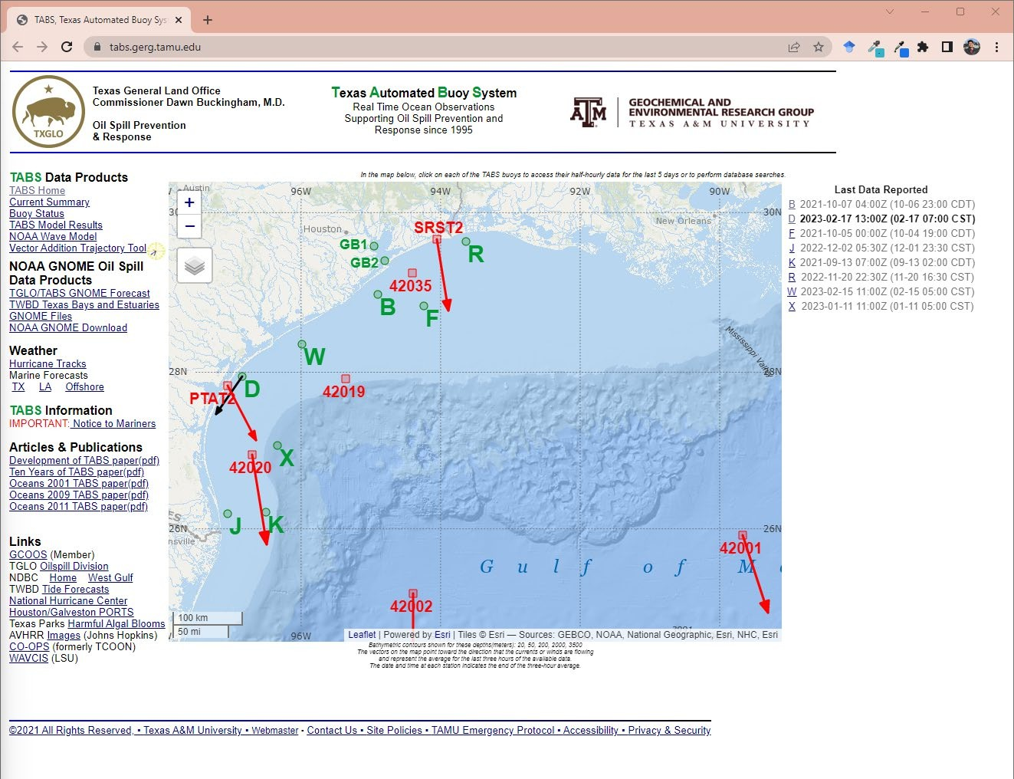
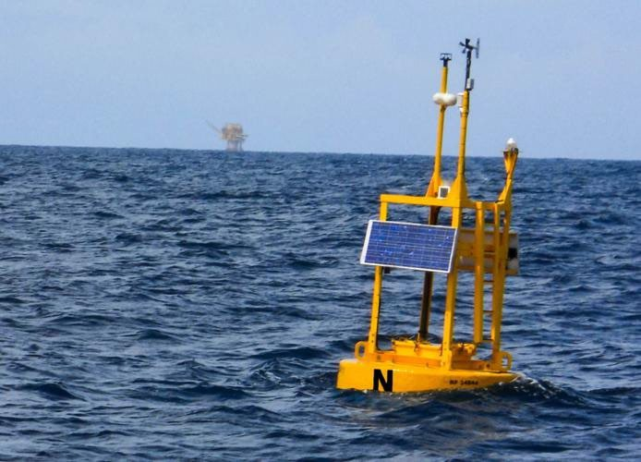
What is TABS?
TABS = Texas Automated Buoy System in the Gulf
Funded by the Texas General Land Office (TGLO)
Managed and operated by TAMU Geochemical and Environmental Research Group (GERG)
https://www.thebatt.com/news/combatting-hurricane- season/article_cd53b0a0-adb8-11e9-b100-27d095749efd.html

Slide 5
Get buoy data:
Select a buoy (green letters on the map OR letters from the list on the right)

Slide 6
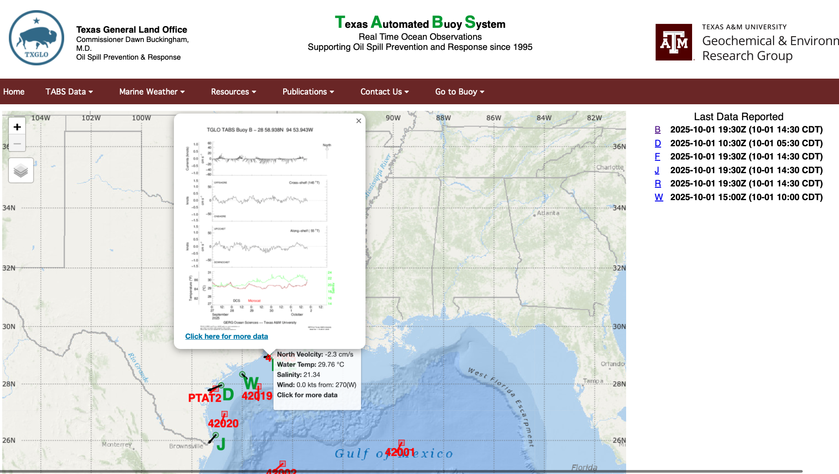
Get buoy data:
Click the “click here for more data”

Slide 7
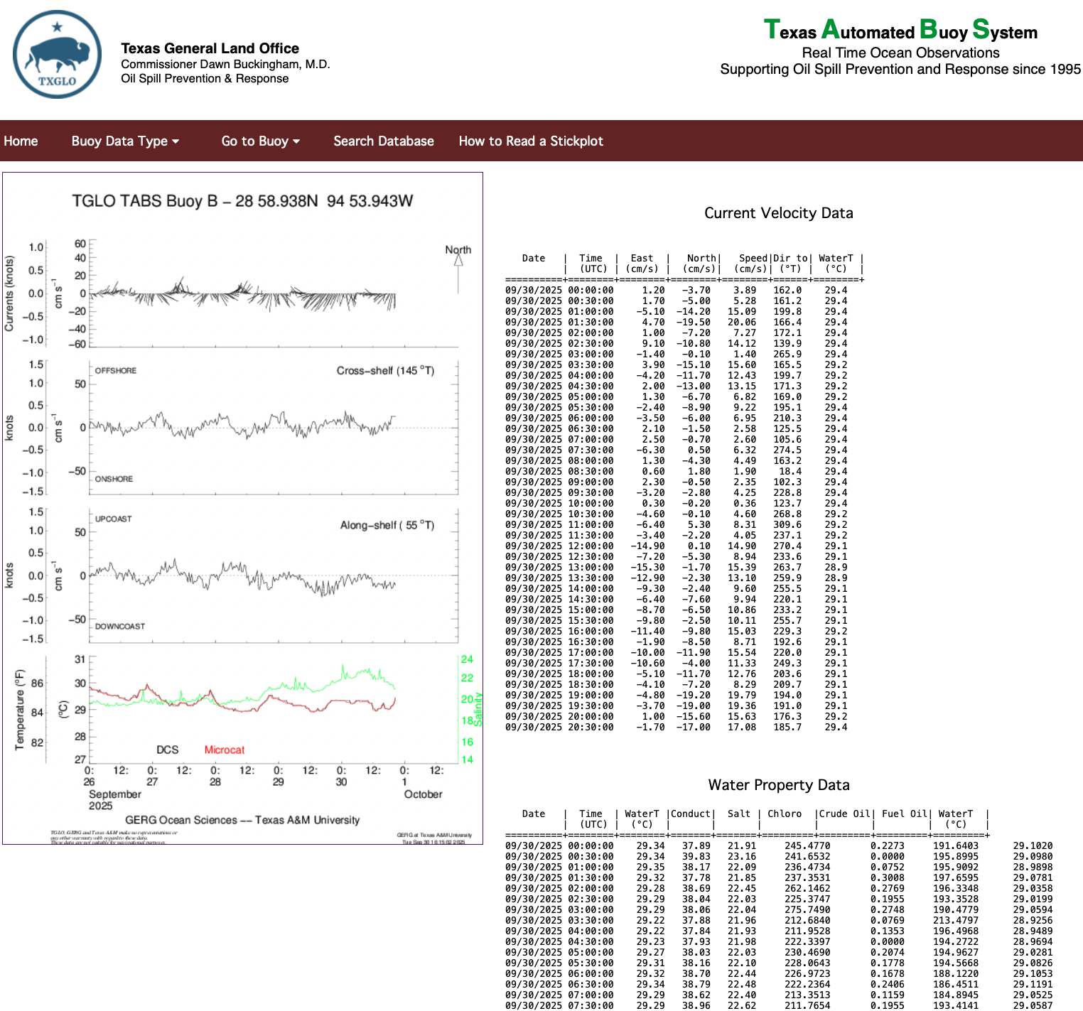
Get buoy data:
Select a buoy (green letters on the map OR letters from the list on the right)
You will be redirected to the individual page of each buoy
Select “search database” TABS Database on the left

Slide 8
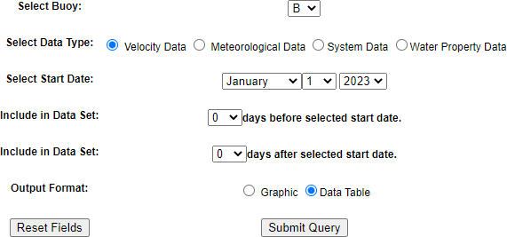
Get buoy data:
Select a buoy (green letters on the map OR letters from the list on the right)
You will be redirected to the individual page of each buoy
Select “search” TABS Database on the left
Set the export parameters before
“submit query”
  Output format: “Data Table”
Make sure that your data covers the targeted interval described in our lab instructions
You might need to doubleclick or right click to chose ”download linked file as”

Slide 9
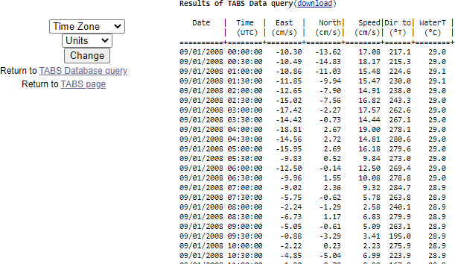
To get buoy data:
After “submit query,” you will be redirected to the data table
  If the data is EMPTY, you will see only the column headers
Make sure you take notes of the column names
Click “download” at the top of the data
Table

Slide 10
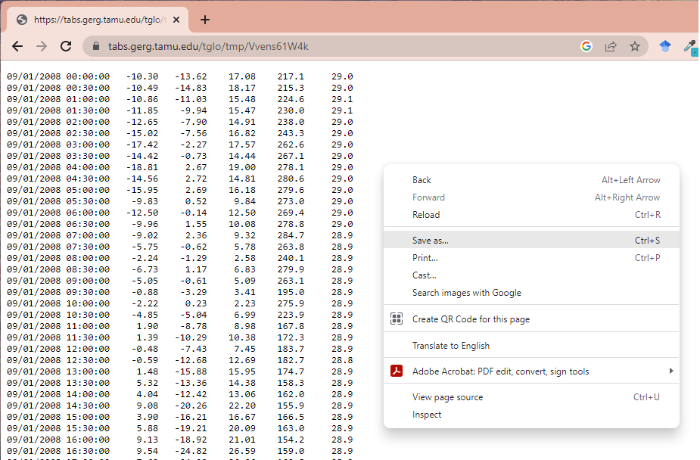
To get buoy data:
Right-click and save as your data into a txt file
After “submit query,” you will be redirected to the data table
  If the data is EMPTY, you will see only the column headers
Make sure you take notes of the column names
Click “download” at the top of the data
table
After getting redirected to the data table page, right-click to save your data into a .txt file. Following the file naming convention below:
Filename: TABS_buoyXXX_sep2008.txt
where: XXX = the selected buoy (you should replace this with the buoy name you selected (e.g., buoyB for B or buoyW for W)

Slide 11
Import your data into a data table using
Remember that your exported data don’t come with column names
After importing your data into a MATLAB table, you should rename your column headers
  MATLAB will automatically set the column names as Var1, Var2, …, Var7
  Change the column names to follow the names that you noted from the data webpage
    use renamevars() to change your column names (see the instructions for an example
code)

Slide 12
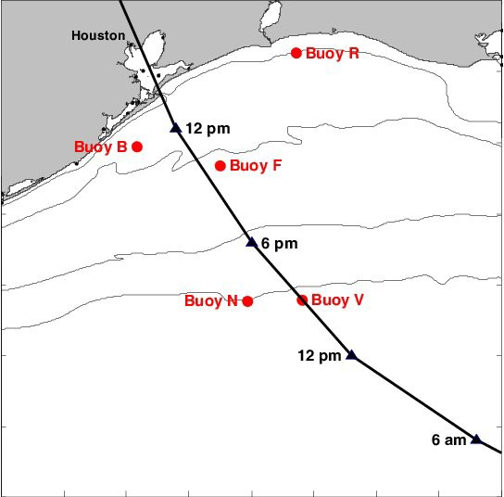
Part A (Must Read)
The track of Hurricane Ike from 5 am September 12 to 5 pm September 13, 2008, and the location of TABS buoys. Times are in CDT.
(Retrieved from Guinasso et al. 2009)
  Select a buoy on the map. As we will see the effects of Hurricane Ike, please use the map below for your buoy selection.
  Use the data query to select 30 days of velocity data in “Data Table” format.
    Be sure that your selection includes 10-18 September 2008.
    Note:
    Some buoys may not have data available from the targeted period. Change your “Buoy” if your TABS data query is EMPTY.
    You might need to doubleclick or right click to chose ”download linked file as”

